Slide 1
Introduction to Web Application
Element types
Directive
Life cycle

Slide 2
Data-Driven Websites
Websites that provide access to:
Lots of data
Dynamic data
Customized views of data
E.g. ebay.com
Scripts map data to html
Database
html

Slide 3
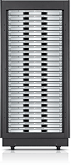

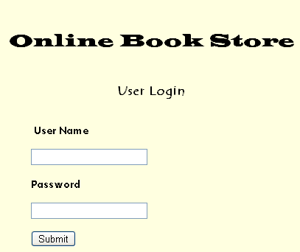
GET/Home.html HTTP/ 1.1
Host: www.onebookstore.com
User-Agent: Mozilla/5.0(Windows..
…..
http://www.onebookstore.com/Home.html
USER
HTTP/1.1 200 OK
Set-Cookie:…
…
<html><body>
<h1 align=….
Finds the page and generates Http response

Slide 4
Http Request
HTTP GET
The total amount of characters in a GET is really limited (depending on the server)
The data you send with the GET is appended to the URL up in the browser bar, so whatever you send is exposed
Because of this, the user can bookmark a form submission if you use GET
HTTP POST
The data in included in the request body
More data can be sent

Slide 5
Servlets
The purpose of a servlet is to create a Web page in response to a client request
Servlets are written in Java, with a little HTML mixed in
The HTML is enclosed in out.println( ) statements

Slide 6
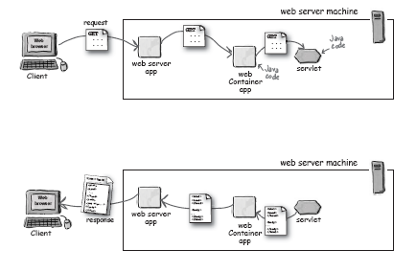
Web Server vs Web Container

Slide 7
Web Container
Communications support
The container provides an easy way for your servlets to talk to web server. You don’t have to build a ServerSocket, listen on a port, create streams, etc.
The Container knows the protocol between the web server and itself,
Lifecycle Management
It takes care of loading the classes, instantiating and initializing the servlets, invoking the servlet methods, and making servlet instances eligible for garbage collection
Multithreading Support
The Container automatically creates a new Java thread for every servlet request it receives
Declarative Security
With a Container, you get to use an XML deployment descriptor to configure (and modify) security without having to hard-code it into your servlet (or any other) class code
You can manage and change your security without touching and recompiling your Java source files.
JSP Support
The container takes care of translating a jsp file into java code

Slide 8
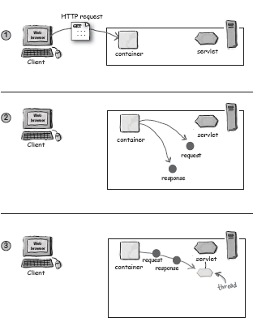
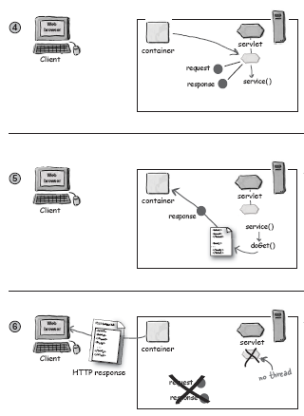

Slide 9
A “Hello World” servlet (from the Tomcat installation documentation)
public class HelloServlet extends HttpServlet {
public void doGet(HttpServletRequest request, HttpServletResponse response) throws ServletException, IOException {
response.setContentType("text/html");
PrintWriter out = response.getWriter();
out.println("<HTML>\n" +
"<HEAD><TITLE>Hello</TITLE></HEAD>\n" +
"<BODY BGCOLOR=\"#FDF5E6\">\n" +
"<H1>Hello World</H1>\n" +
"</BODY></HTML>");
}
}

Slide 10
A more meaningful one
public class HelloServlet extends HttpServlet {
List<StudyMaterials> stList=new ArrayList<…> stList();
public void doGet(HttpServletRequest request, HttpServletResponse response) throws ServletException, IOException {
response.setContentType("text/html");
PrintWriter out = response.getWriter();
for(StudyMaterials st: this.stList)
out.println(“Title “ + stList.getTitle() + “ URL: “ + stList.getURL());
}
}

Slide 11
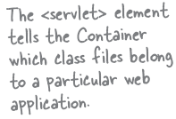
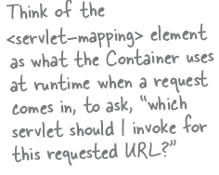
Deployment Descriptor
<?xml version="1.0" encoding="ISO-8859-1"?>
<web-app xmlns="http://java.sun.com/xml/ns/j2ee"
xmlns:xsi="http://www.w3.org/2001/XMLSchema-instance"
xsi:schemaLocation="http://java.sun.com/xml/ns/j2ee http://java.sun.com/xml/ns/j2ee/web-app_2_5.xsd” version="2.5“>
<servlet>
<servlet-name>Form1</servlet-name>
<servlet-class>book.HelloServlet</servlet-class>
</servlet>
<servlet-mapping>
<servlet-name>Form1</servlet-name>
<url-pattern>/store/home.do</url-pattern>
</servlet-mapping>
</web-app>
Resultant URL
– http://hostname/webappName/MyAddress

Slide 12
Deployment Descriptor
The deployment descriptor (DD), provides a “declarative” mechanism for customizing your web applications without touching source code!
The actual path name for a servlet is not specified
Minimizes touching source code that has already been tested.
Lets you fine-tune your app’s capabilities, even if you don’t have the source code.
Lets you adapt your application to different resources (like databases), without having to recompile and test any code.
Makes it easier for you to maintain dynamic security info like access control lists and security roles.
Lets non-programmers modify and deploy your web applications

Slide 13
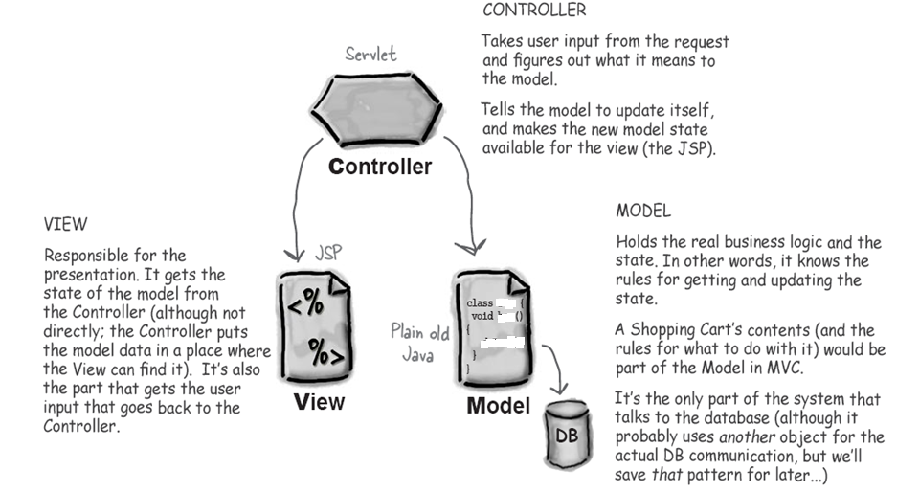
MVC
Model*View*Controller (MVC) takes the business logic out of the servlet, and puts it in a “Model”— a reusable plain old Java class.
The Model is a combination of the business data (like the state of a Shopping Cart) and the methods (rules) that operate on that data.

Slide 14
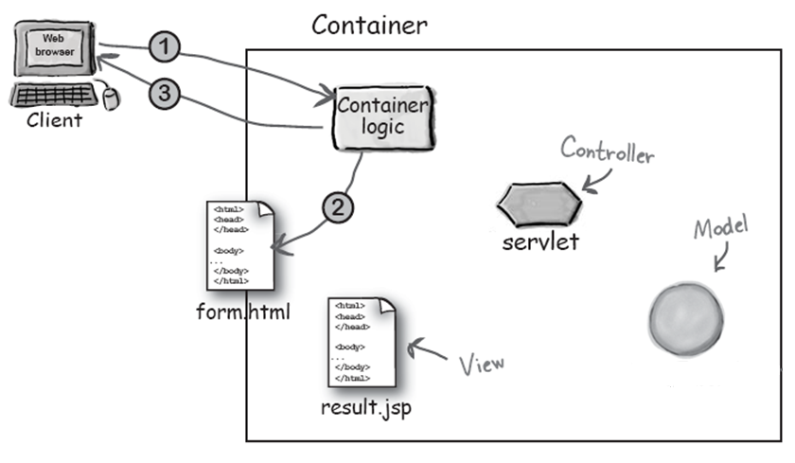

Slide 15
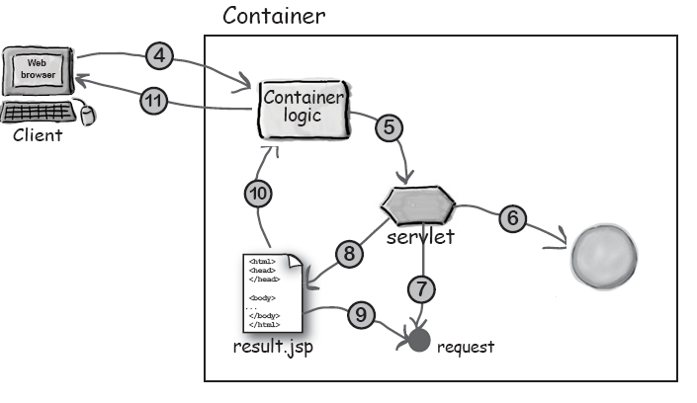

Slide 16
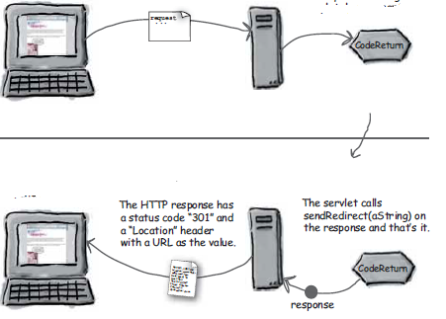
Send Redirect
response.sendRedirect(http://www.abc.in);

Slide 17
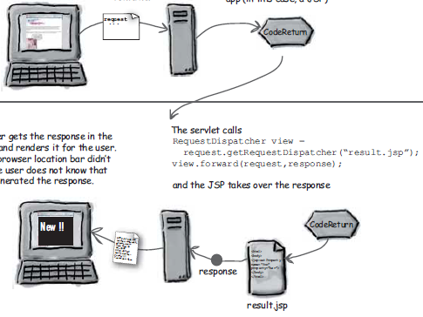
Request Dispatcher

Slide 18
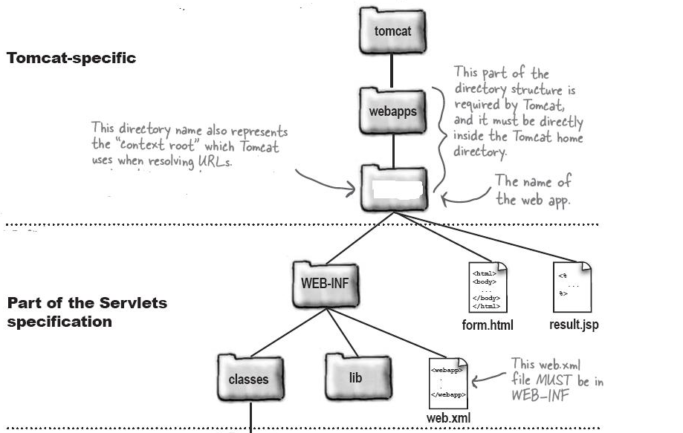
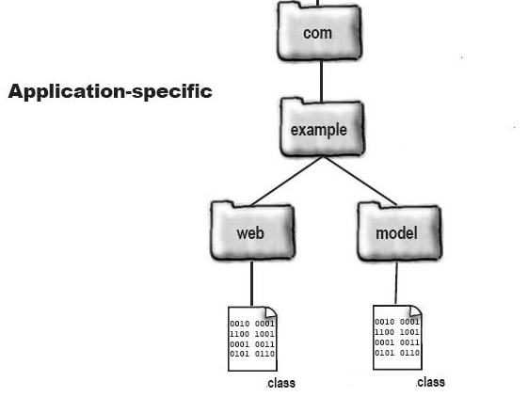

Slide 19
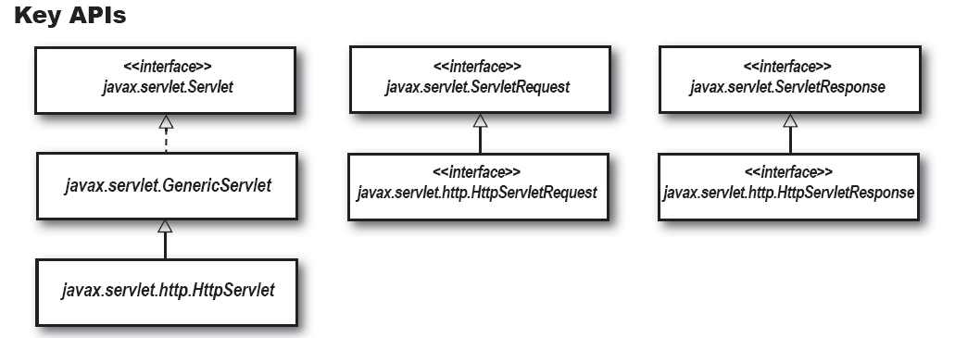
APIs
Compiling your servlet
Javac –classpath /…./tomcat/common/lib/servlet-api.jar; <servlet name>

Slide 20
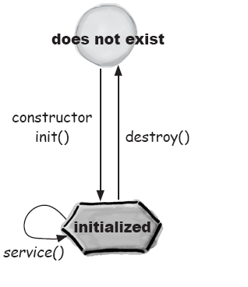
Servlet Lifecycle

Slide 21
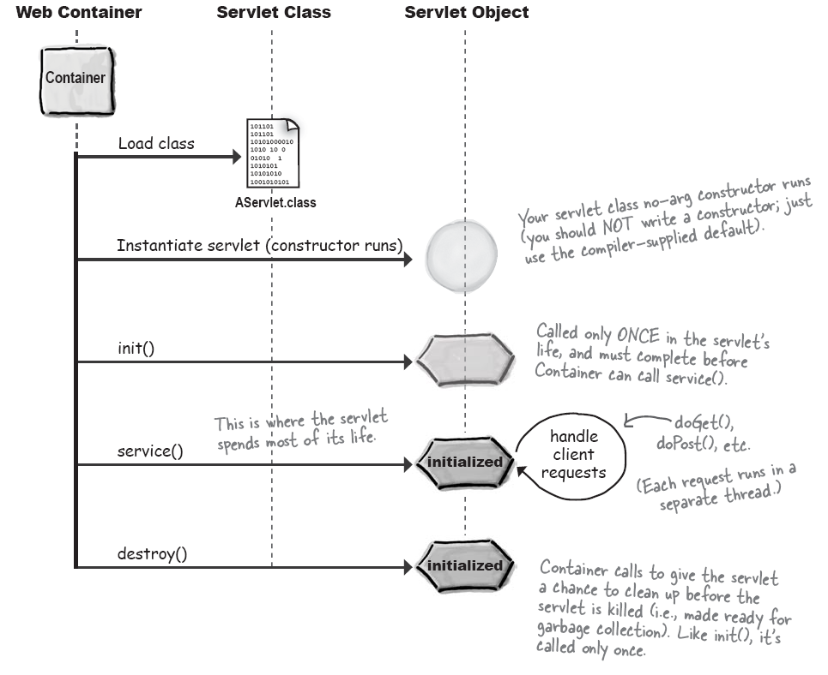

Slide 22
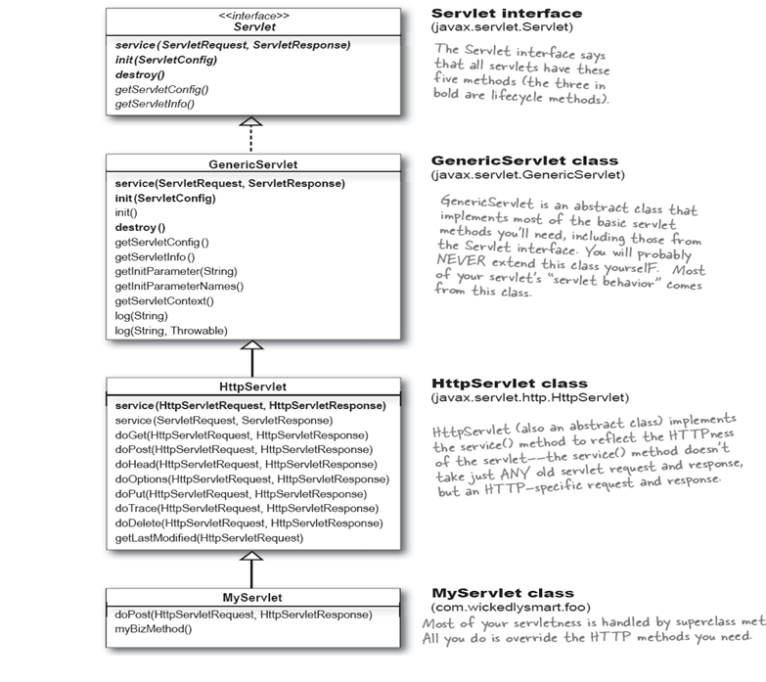

Slide 23
Three Big Lifecycle Moments
Init()
If you have initialization code (like getting a database connection or registering yourself with other objects), then you’ll override the init() method in your servlet class
Service()
You should NOT override the service() method. Your job is to override the doGet() and/or doPost() methods and let the service() implementation from HTTPServlet worry about calling the right one.
doGet() or doPost()
Whichever one(s) you override tells the Container what you support

Slide 24
What makes an object a servlet
ServletConfig Object
One ServletConfig object per servlet
Use it to pass deploy-time information to the servlet (a database for example) that you don’t want to hard-code into the servlet (servlet init parameters)
Use it to access the ServletContext.
Parameters are configured in the Deployment Descriptor.

Slide 25
What makes an object a servlet
One ServletContext per web app
Use it to access web app parameters (also configured in the Deployment Descriptor).
Use it as a kind of application bulletin-board, where you can put up messages (called attributes) that other parts of the application can access.
Use it to get server info, including the name and version of the Container, and the version of the API that’s supported.

Slide 26
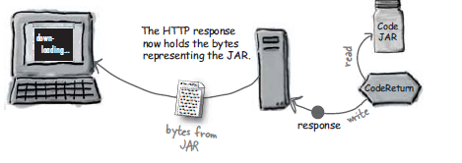
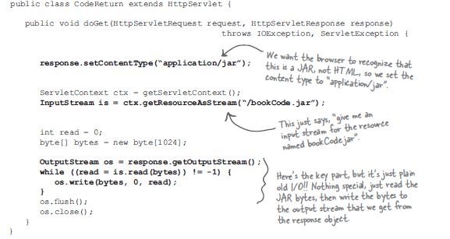
Download a JAR

Slide 27
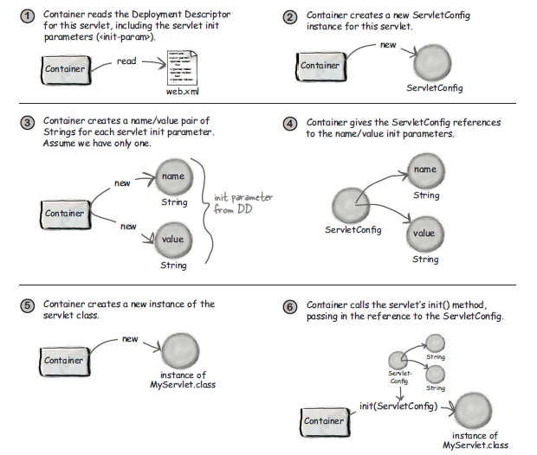

Slide 28
ServletConfig parameters
<servlet>
<servlet-name>InitTest</servlet-name>
<servlet-class>moreservlets.InitServlet</servlet-class>
<init-param>
<param-name>firstName</param-name>
<param-value>BCSE4</param-value>
</init-param>
<init-param>
<param-name>emailAddress</param-name>
<param-value>abc@jdvu.ac.in</param-value>
</init-param>
</servlet>
<servlet-mapping>
<servlet-name>InitTest</servlet-name>
<url-pattern>/showInitValues</url-pattern>
</servlet-mapping>

Slide 29
Read Config Parameter
public class InitServlet extends HttpServlet {
private String firstName, emailAddress;
public void init() {
ServletConfig config = getServletConfig();
firstName =config.getInitParameter("firstName");
if (firstName == null) {
firstName = "Missing first name";
}
emailAddress =config.getInitParameter("emailAddress");
if (emailAddress == null) {
emailAddress = "Missing email address";
}
}

Slide 30
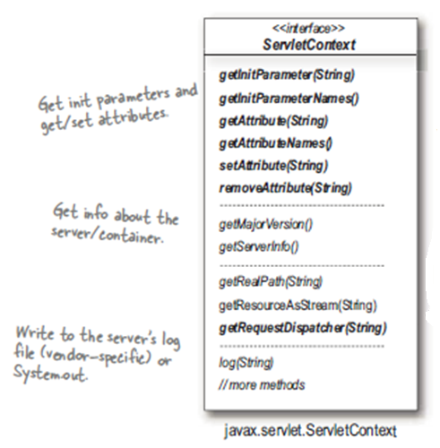
ServletContext Parameter
getServletConfig().getServletContext().getinitParameter()

Slide 31
ServletContext Parameter
<?xml version="1.0" encoding="ISO-8859-1" ?>
<web-app …>
<context-param>
<param-name>email</param-name>
<param-value>abc@gmail.com</param-value>
</context-param>
</web-app>
Use getServletContext().getInitParameter() to read context params from servlet

Slide 32
Attributes
An attribute is a name/value pair in a map instance variable
An attribute is either bound to a ServletContext, HttpServletRequest or an HttpSession object
There is no servlet specific attribute
Return type of an attribute is an object

